Slide 1


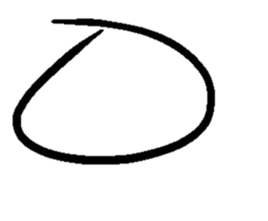

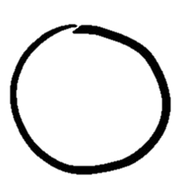
when and why to replicate...
as easy as 1, 2, 3?
EXTRACT results from original paper
to select
your replication target:
1.
3.
REANALYZE: make p-values into Bayes factors, & select results closest to 1
REFINE selection
using qualitative criteria (e.g.,
theoretical importance & relevance)
2.
Scan for
preprint!
UNIVERSITY OF GRONINGEN:
Sarahanne Field, Rink Hoekstra,
Laura Bringmann & Don van Ravenzwaaij

